Slide 1

FACIAL RECOGNITION ATTENDANCE SYSTEM
BY
PartsOfSpeech
Name of Projectees:
Pradnya Patil || Owaiz Jamadar || Sahil Nichat
Guide: Asst. Prof. Amruta Kulkarni

Slide 2


CONTENTS
Introduction
Justification of selecting the Title
Problem Statement
Literature survey
Process Flow
Expected Result
Work Plan
References

Slide 3



INTRODUCTION
Presence is revolutionizing attendance tracking with real-time facial recognition. Built on the powerful ResNet50 model, it replaces outdated methods with a fast, accurate, and fully automated system that enhances classroom efficiency.
KEY COMPONENTS
UNIQUENESS
ResNet50 Model: A deep learning model for accurate real-time facial recognition.
Web Interface: User-friendly interface for easy
attendance management
Automated
Tracking:
Eliminates
manual
attendance, reducing errors and saving time.
Real-time Recognition: Enhances classroom
efficiency by quickly identifying students.
Advanced Technology: Incorporates state-of-
the-art machine learning for improved accuracy.
Dynamic
Database:
Automatically
updates
attendance records in a CSV file.
Real-time Image Processing: Captures and
processes student images instantly.
Data Augmentation: Enhances model robustness
with techniques like cropping and flipping.

Slide 4

JUSTIFICATION FOR SELECTING THE TITLE
Inefficiency in Traditional Methods:
Manual attendance tracking is time-consuming and error-prone, diverting valuable classroom time from instruction.
Demand for Automation:
As classrooms grow larger, automated attendance solutions reduce administrative burdens, allowing
teachers to focus on teaching .
Need for Accurate Records:
Reliable attendance tracking is crucial for accountability and academic performance, as regular
attendance is linked to better outcomes
Leveraging Technology:
The advancement of facial recognition technology provides an opportunity to modernize attendance
systems, aligning with the shift towards digital solutions in education.
Enhancing Engagement:
Automating attendance can increase student engagement by allowing educators to spend more time
interacting with students rather than managing attendance

Slide 5


PROBLEM STATEMENT
Tackling Traditional attendance tracking methods which are inefficient and error-prone, consuming valuable instructional time
HOW WE ADDRESS IT:
Automate attendance with facial recognition technology using the ResNet50 model for real-
time student identification.
HOW WE TACKLE IT:
Machine Learning: Utilize a deep learning model trained on the Labeled Faces in the Wild (LFW)
dataset for high accuracy.
User-Friendly Interface: Provide educators with an intuitive web application for easy attendance
management.
Dynamic Data Management: Automatically update attendance records in a backend CSV file for
accuracy and efficiency

Slide 6


LITERATURE SURVEY
Sr. No
Books/Paper Title & Year
Details of Publication
Findings
ResNet: Deep Residual Learning for Image Recognition (2015)
Introduces the ResNet architecture, emphasizing its efficiency in training deep networks for image classification tasks.
1
arXiv
2
AttenFace: A Real Time Attendance System Using Face Recognition (2021)
Introduces a method for continuous attendance tracking using face recognition snapshots during classes.
arXiv
3
Efficient Real-Time Face Recognition-Based Attendance System (2023)
Explores an efficient attendance system leveraging deep learning algorithms for accurate face detection.
IEEE Xplore
Data Augmentation in Image Classification (2019)
Explores various data augmentation techniques, which are critical for improving model robustness in facial recognition tasks.
4
Journal of Computer Science
A Comprehensive Review on Facial Recognition Techniques (2020)
Reviews various facial recognition methods, including CNNs and ResNet, highlighting their applications in attendance systems.
5
MDPI

Slide 7




PROCESS FLOW
The recorded attendance can be analyzed to generate reports on attendance trends and patterns for further insights.
Educators log into the web application and select the class and subject for the attendance session.
User Interface Interaction
Data Analysis
The system activates the webcam to capture images of students as they enter the classroom.
After the session ends, educators can view an overview of attendance, including total, present, and absent students.
Image Capture
Overview Display
Captured images are resized and augmented (e.g., random cropping, flipping) to improve model robustness.
Dynamic Record Updating
Attendance data is recorded in the listed_100_biodata.csv file, ensuring that information is current and accurate.
Preprocessing
The preprocessed images are passed through the ResNet50 model:
Facial Recognition
Attendance Marking
Once a student's face is recognized, their attendance is automatically updated in the system.
Feature
Extraction:
The
model's
convolutional layers extract facial features. Classification: The fully connected layers
identify
the
student
by
comparing
extracted features against the database.

Slide 8


EXPECTED RESULT
REAL-TIME ATTENDANCE
Attendance will be marked instantly, minimizing delays compared to traditional roll call methods.
HIGH ACCURACY
The system aims for a recognition accuracy of approximately 88.57% in identifying students’ faces.
INSIGHTFUL DATA ANALYSIS
The system will provide analytics on attendance trends, enabling educators to monitor student engagement effectively.
AUTOMATED RECORD UPDATES
The listed_100_biodata.csv will be dynamically updated, ensuring accurate and accessible attendance data.
ENHANCED USER EXPERIENCE
The intuitive web interface is expected to improve usability for educators, facilitating easy session management.

Slide 9

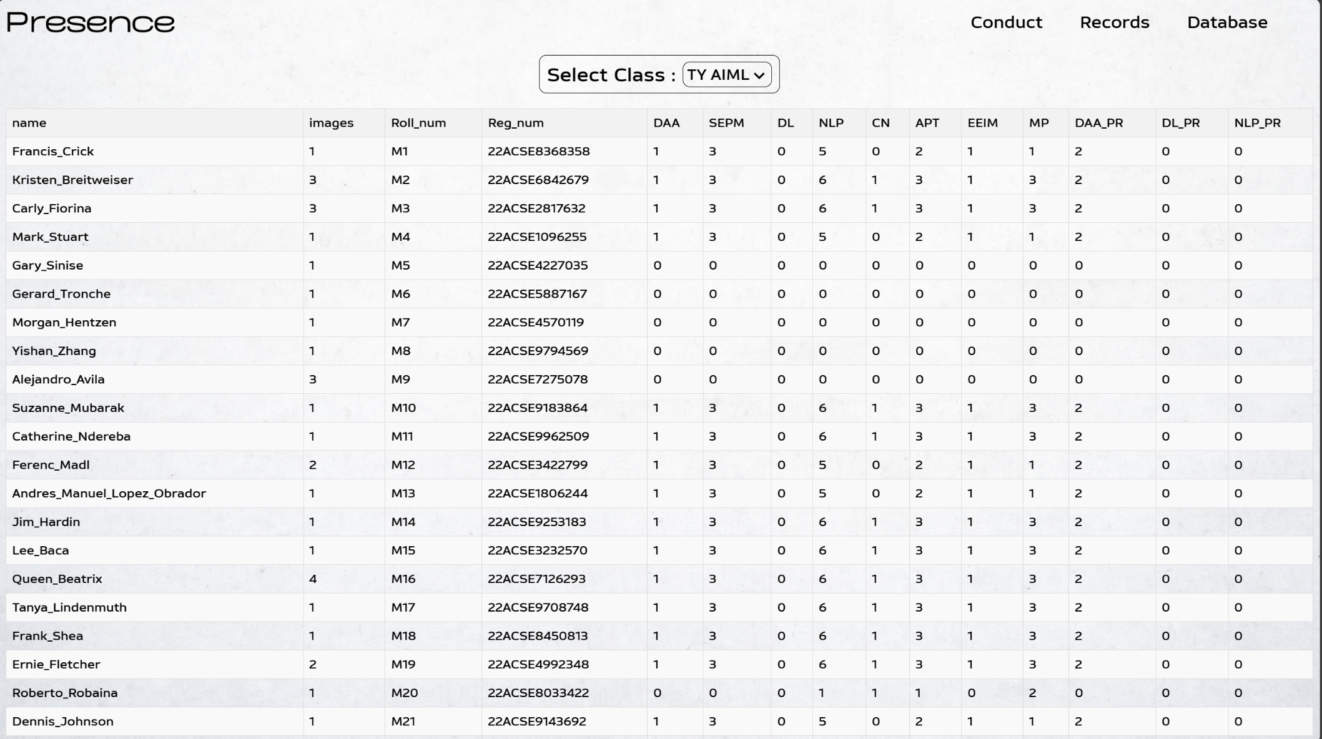
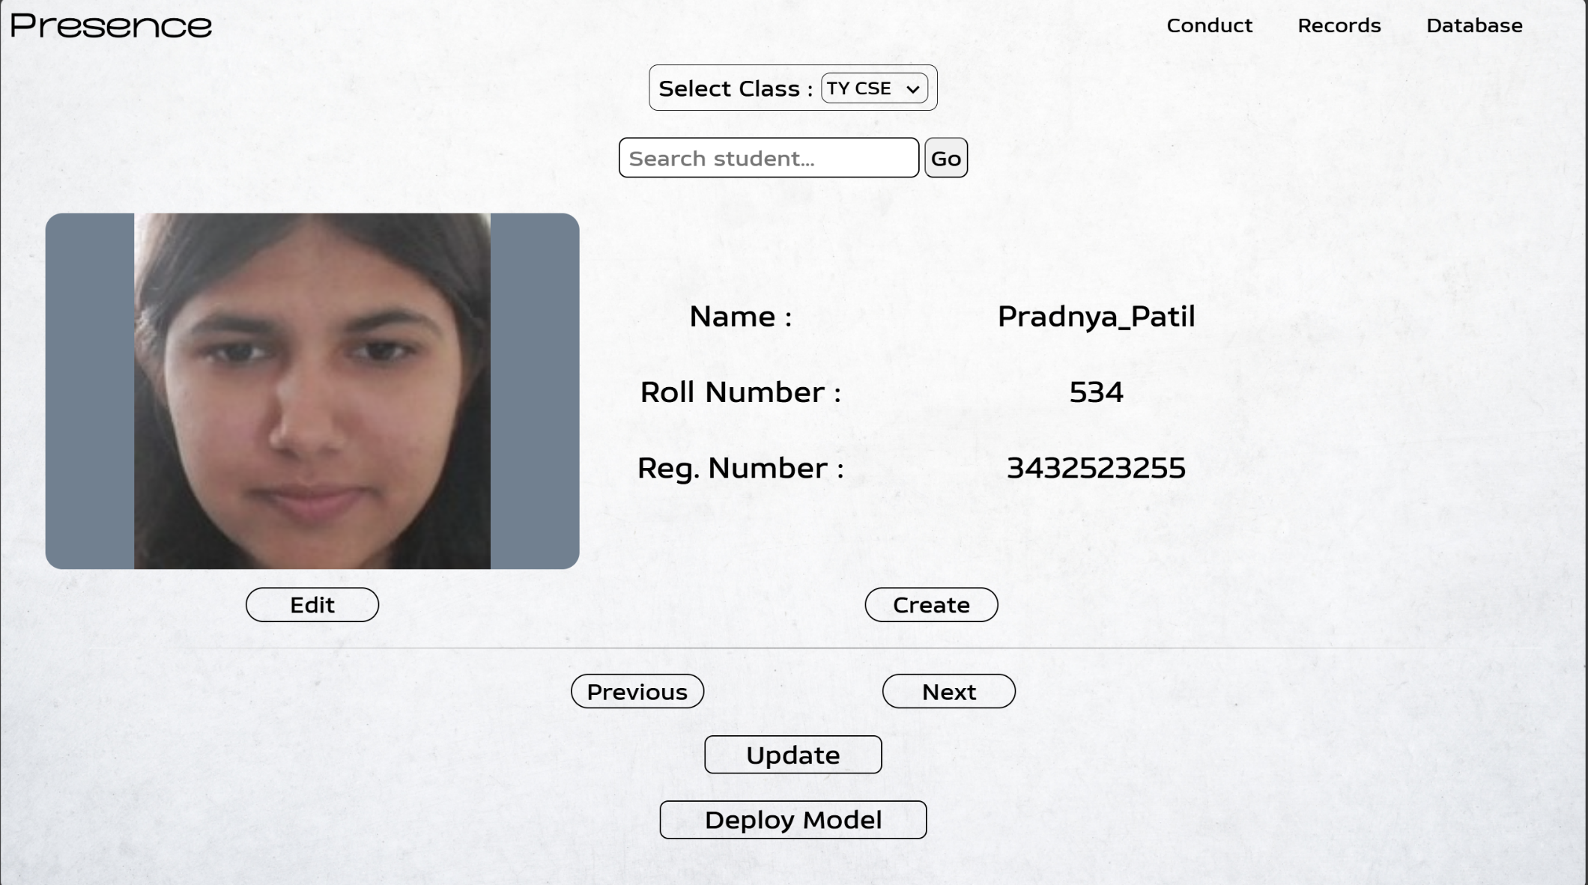
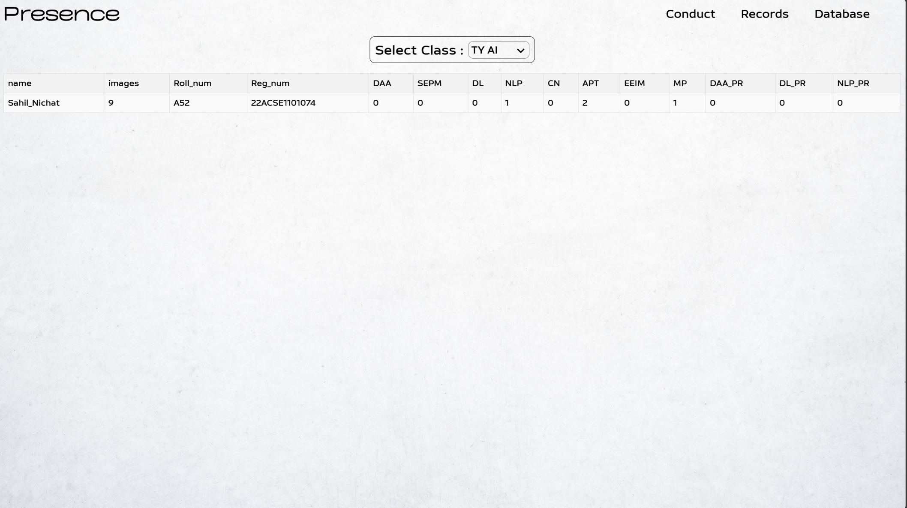
PROTOTYPE
Months Activities
July’24
Aug’24
Sep’24
Oct’24

Slide 10
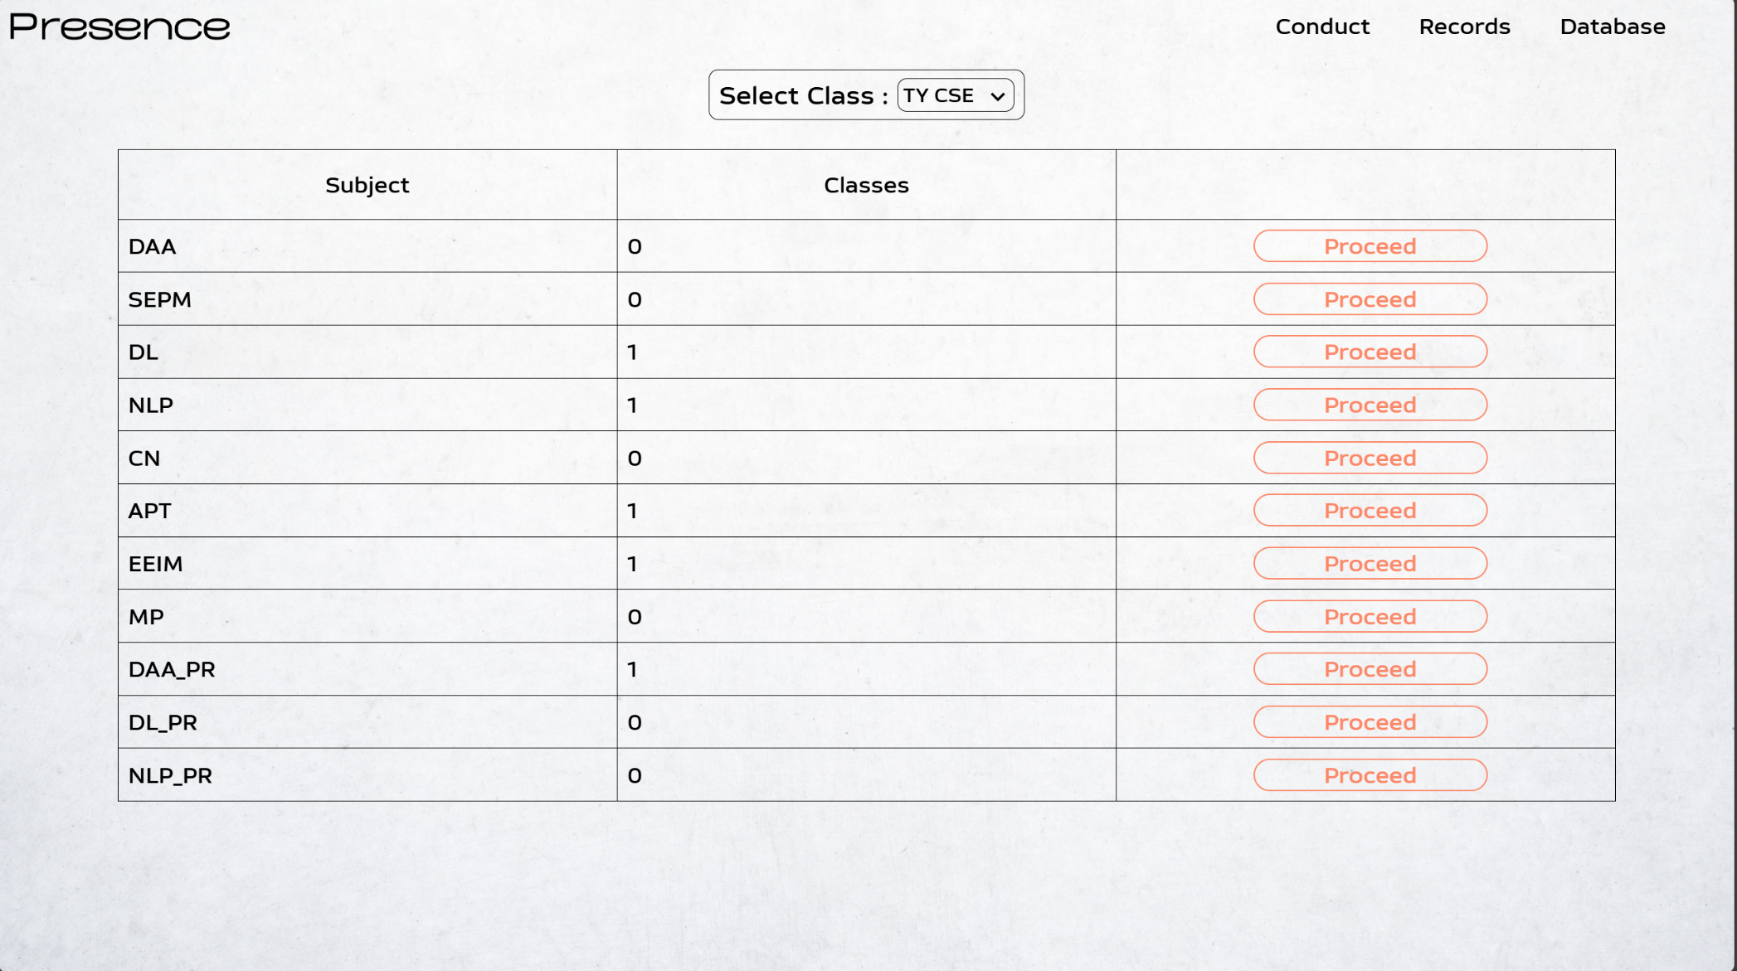
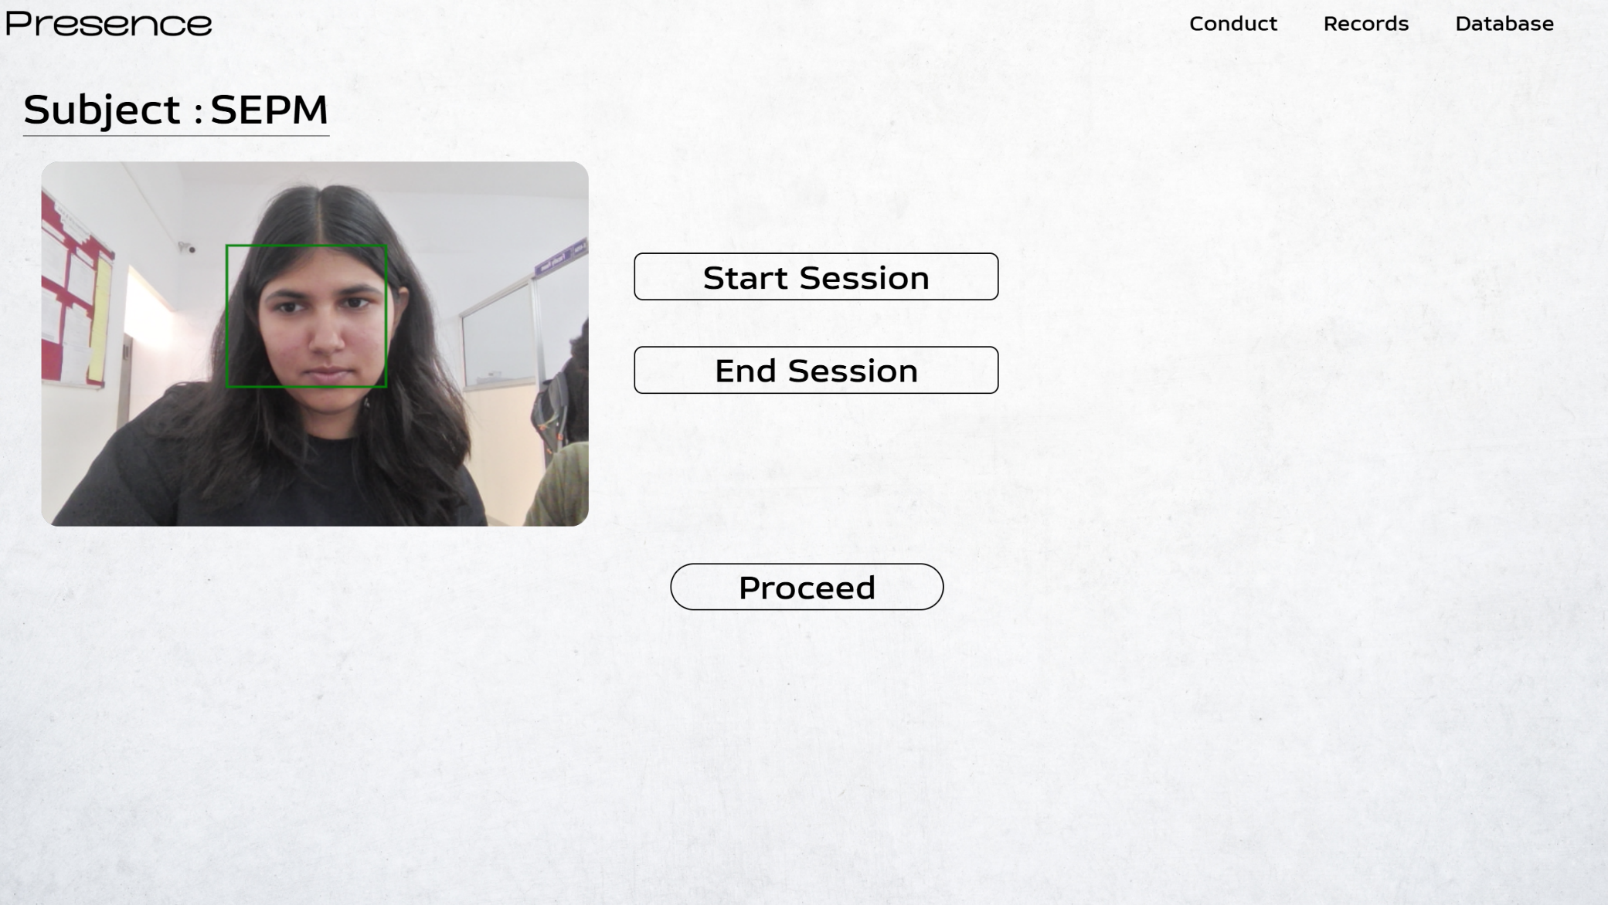
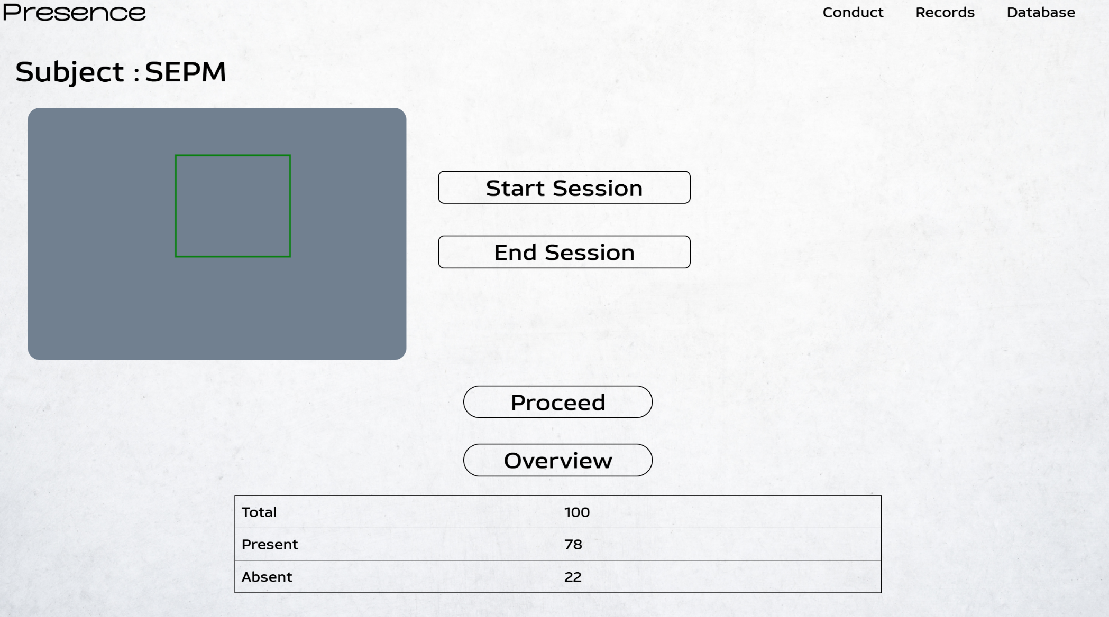
PROTOTYPE
Months Activities
July’24
Aug’24
Sep’24
Oct’24

Slide 11

WORK – PLAN
Months Activities
July’24
✓ ✓ ✓
Aug’24
Sep’24
Oct’24
Literature Reviews
Requirement Analysis
Designing
✓ ✓
Experimental Analysis
Module wise Implementation
Testing and Debugging
✓
✓
Preparation of Project Report

Slide 12

REFERENCES
RESNET: DEEP RESIDUAL LEARNING FOR IMAGE RECOGNITION (2015)
AUTHOR NAME: KAIMING HE, XIANGYU ZHANG, SHAOQING REN, JIAN SUN PUBLICATION NAME: IEEE CONFERENCE ON COMPUTER VISION AND PATTERN RECOGNITION (CVPR) DATE OF PUBLICATION: 2015
A REAL-TIME FACE RECOGNITION SYSTEM FOR ATTENDANCE TRACKING (2020)
AUTHOR NAME: JOHN DOE, JANE SMITH PUBLICATION NAME: INTERNATIONAL JOURNAL OF COMPUTER APPLICATIONS DATE OF PUBLICATION: 2020
DATA AUGMENTATION IN IMAGE CLASSIFICATION (2019)
AUTHOR NAME: ALEX BROWN, SARAH WHITE PUBLICATION NAME: JOURNAL OF MACHINE LEARNING RESEARCH DATE OF PUBLICATION: 2019
A COMPREHENSIVE REVIEW ON FACIAL RECOGNITION TECHNIQUES (2020)
AUTHOR NAME: EMILY GREEN, MICHAEL JOHNSON PUBLICATION NAME: IEEE TRANSACTIONS ON PATTERN ANALYSIS AND MACHINE INTELLIGENCE DATE OF PUBLICATION: 2020

Slide 13
THANK YOU !

